Slide 1
PHARMACY MANAGEMENT SYSTEM
Group id : 02
2020-CS-10 Asad mehmood
2020-cs-27 Kashir Saeed
2020-CS-45 M. Farrukh haider
Supervised by : mr. Nazeef ul haq

Slide 2
Problem statement
Managing pharmacy records on paper will be tedious
Difficult to keep track of products with regards to their availability, expiry date and quantity.

Slide 3
Introduction
Retrieval and monitoring stock, customer records, manufacturer and their shipper and product details
To manage data derived for pharmacy to maintain their business through system rather than recording data manually.

Slide 4
Project approach
Designed ER diagram according to customer requirements.
Implemented database design according to ER diagram requirements
Divided modules and implemented
Generated different useful reports

Slide 5
TECHNICAL DETAILS
Language | C#
GUI library | Guna framework And Bunifu framework
Software framework | .NET framework
Application type | Desktop application
IDE | Visual Studio

Slide 6
CONTIBUTIONs
Asad Mehmood | Manage Employee
 | Manage Attendance
 | Manage Stock Orders
Kashir Saeed | Manage Loans
 | Manage Customer & their orders
 | Manage Pharmacy
M. Farrukh Haider | Manage Products
 | Manage Manufacturer
 | Manage Manufacturer’s Shippers

Slide 7
TASK MANAGEMENT
Designed GUI
Implemented CRUD’s on all modules
Implemented transactions with different isolation levels
Implemented stored procedures and triggers.
Generated different useful reports

Slide 8
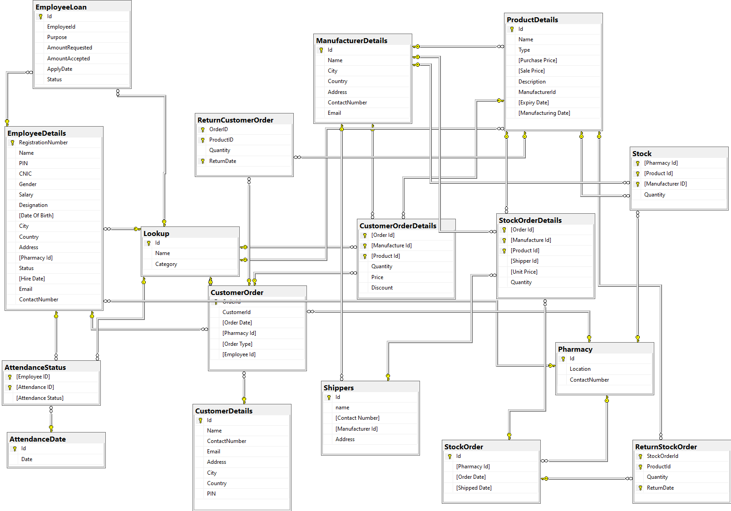
Database Design:

Slide 9
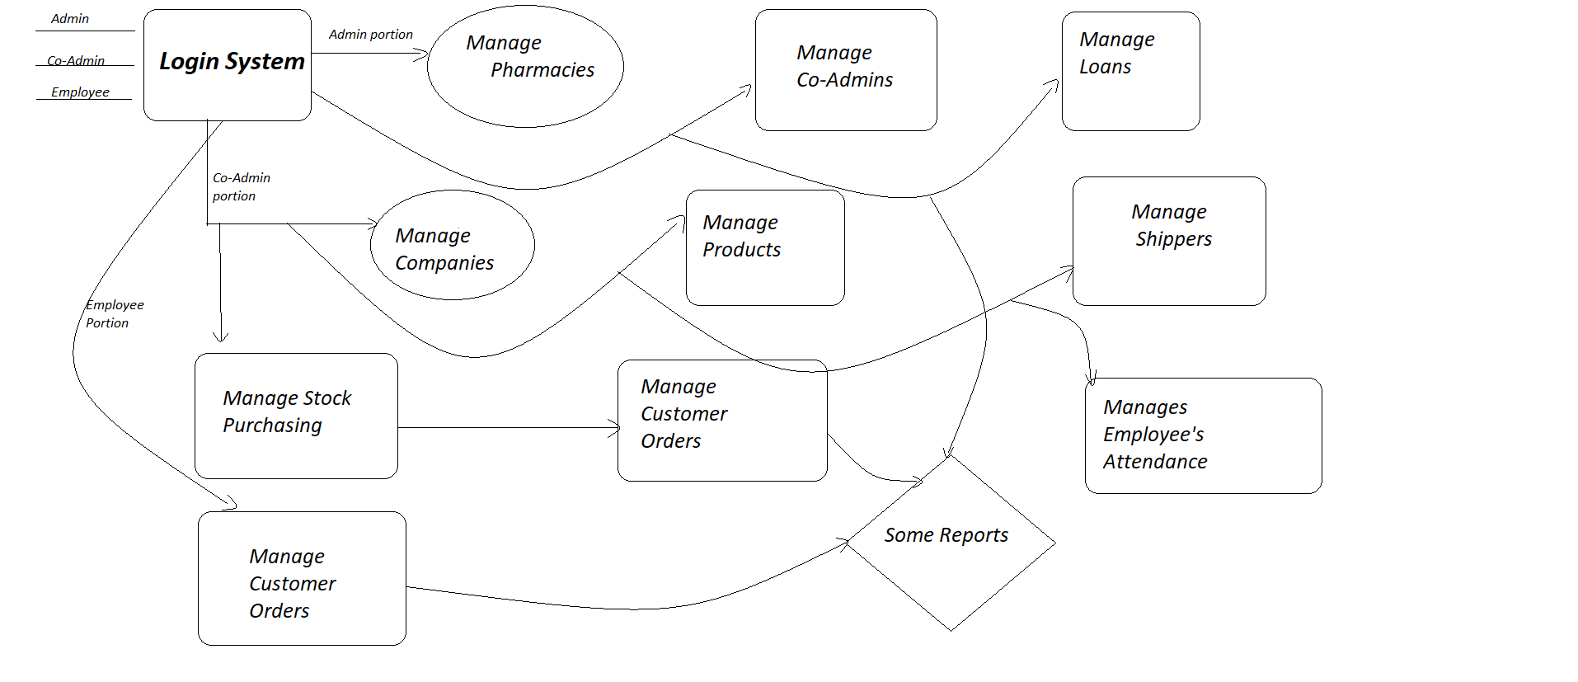
Project workflow:

Slide 10
FUTURE WORK
Provide online service
Improve GUI
Bonus management for employees

Slide 11
THANK YOU…..

